Slide 1
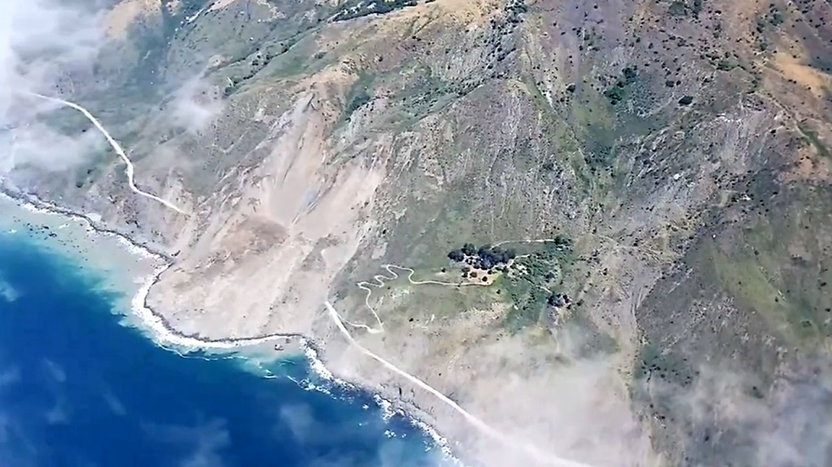


Mapping Landslide Activity in SAR Imagery
Mitch Thompson and Leah Manak
Special Credit to Elsa Culler

Slide 2
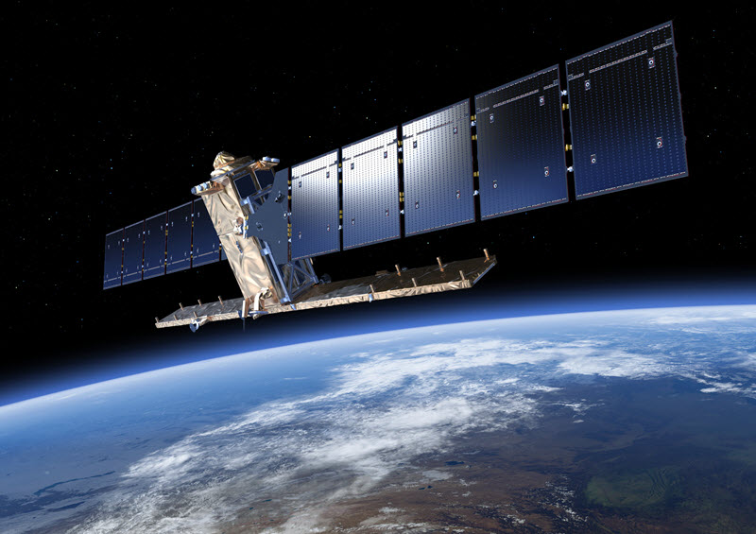
Why Study Landslides With Synthetic Aperture Radar (SAR) Imagery?
It can help to accurately locate landslide information across large spatial scales—especially remote areas.
Beneficial because landslides are:
Costly
Hazardous
Driven by climate change and increased urbanization

Slide 3
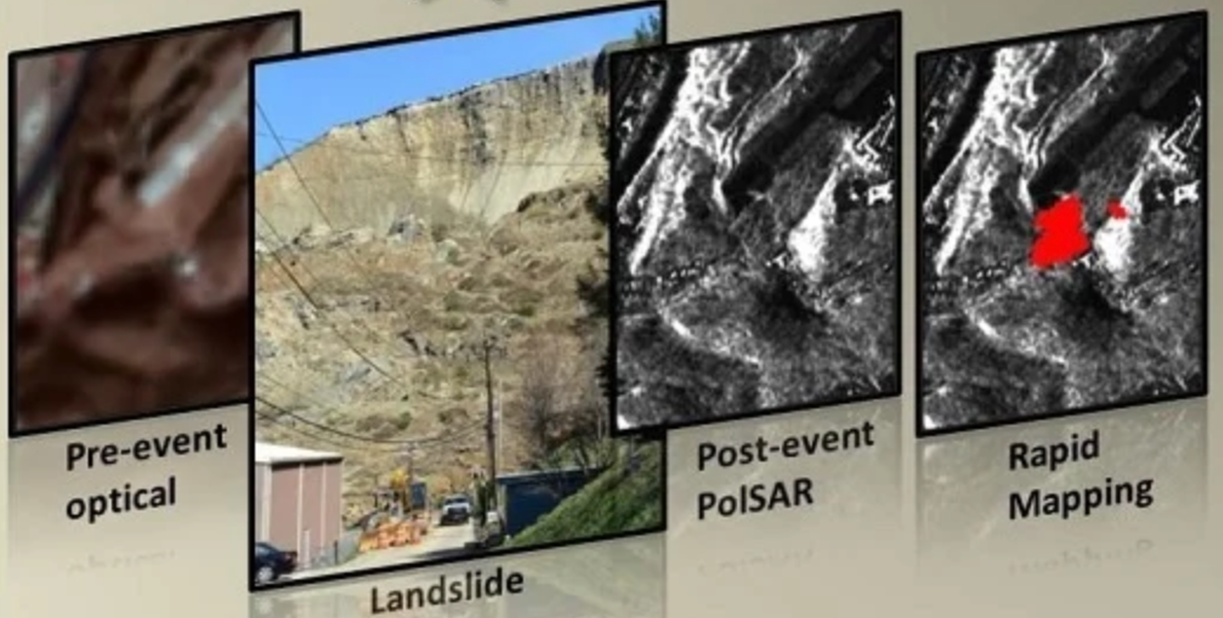
Project Goals:
Integrate an existing low-accuracy large spatial scale landslide database with SAR imagery
Create reproducible code to help integrate SAR and Google Earth Engine tools in landslide detection and monitoring efforts

Slide 4
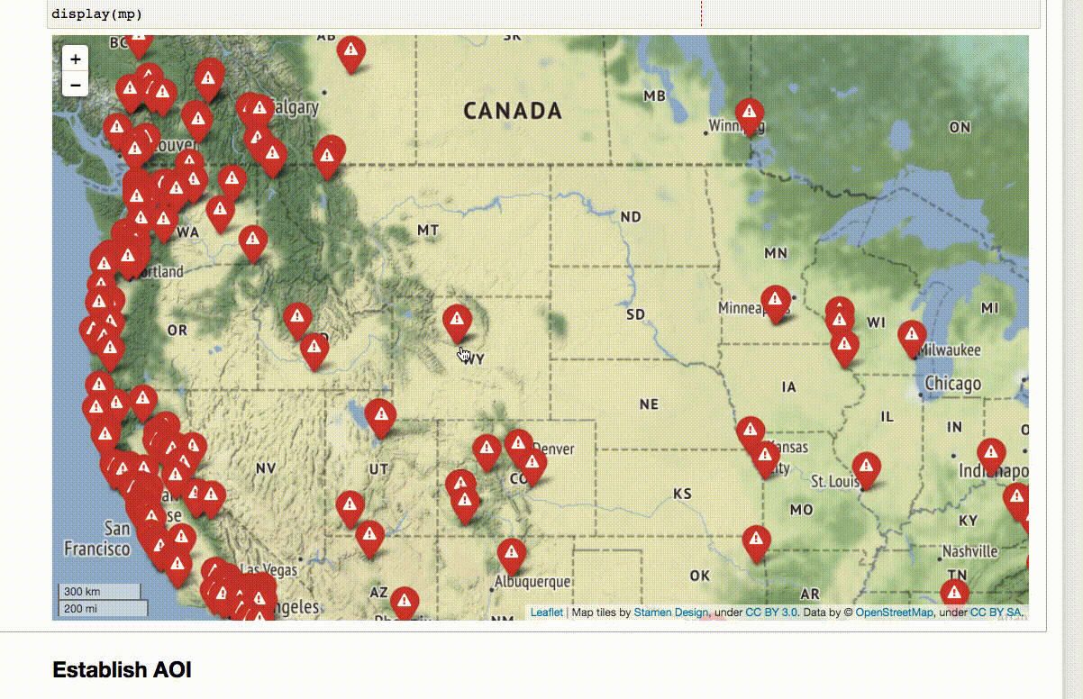
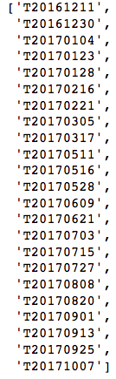
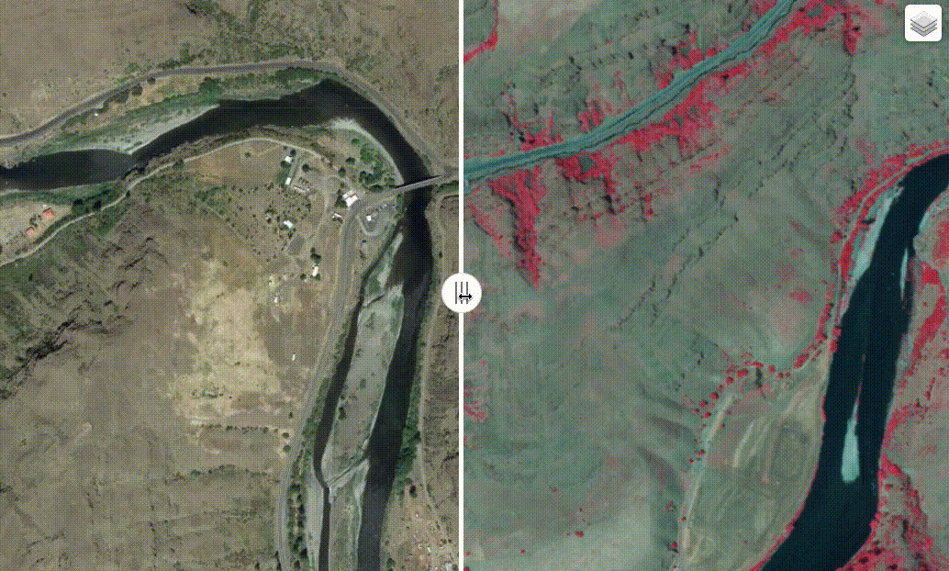
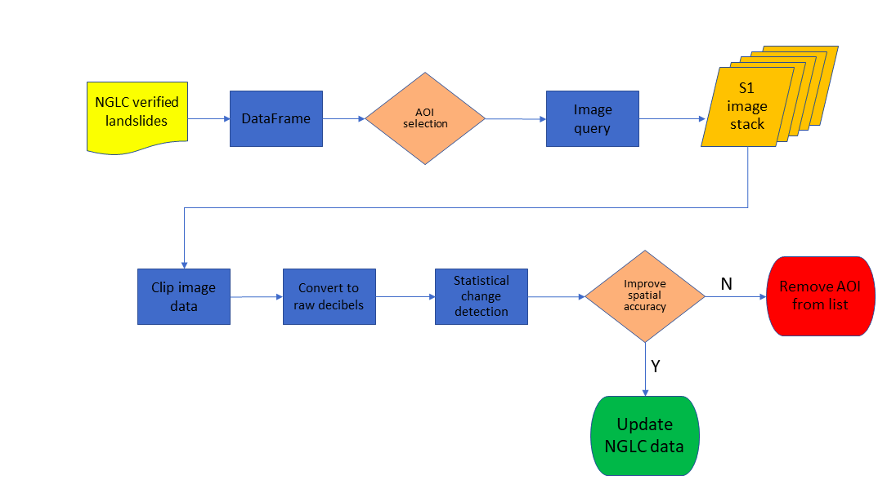
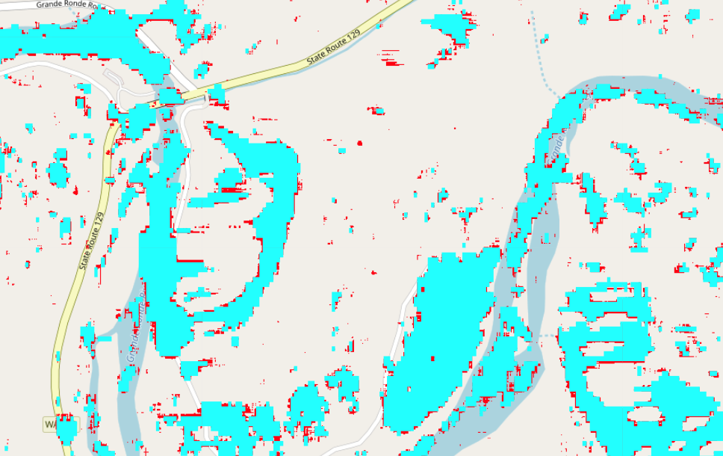



Our Approach
Image List

Slide 5
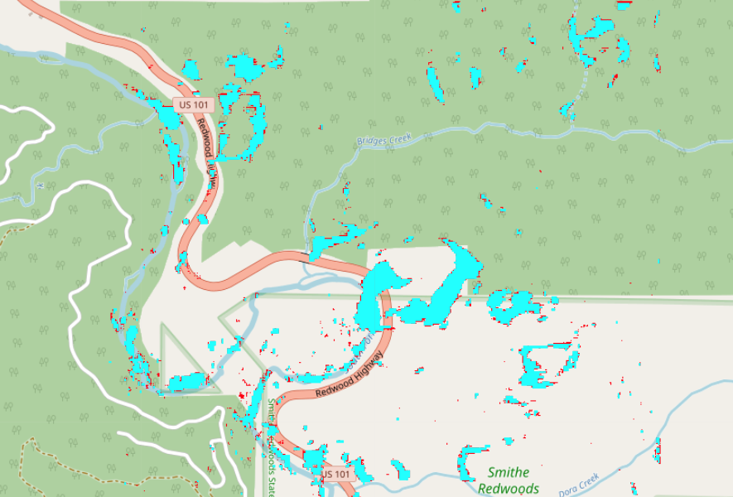
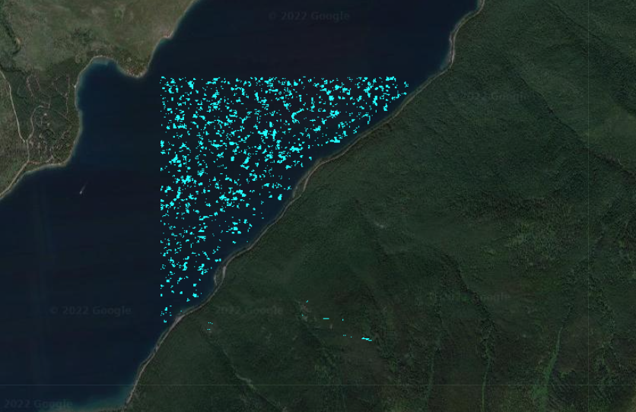
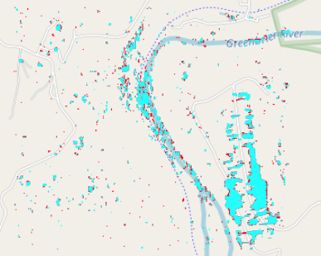
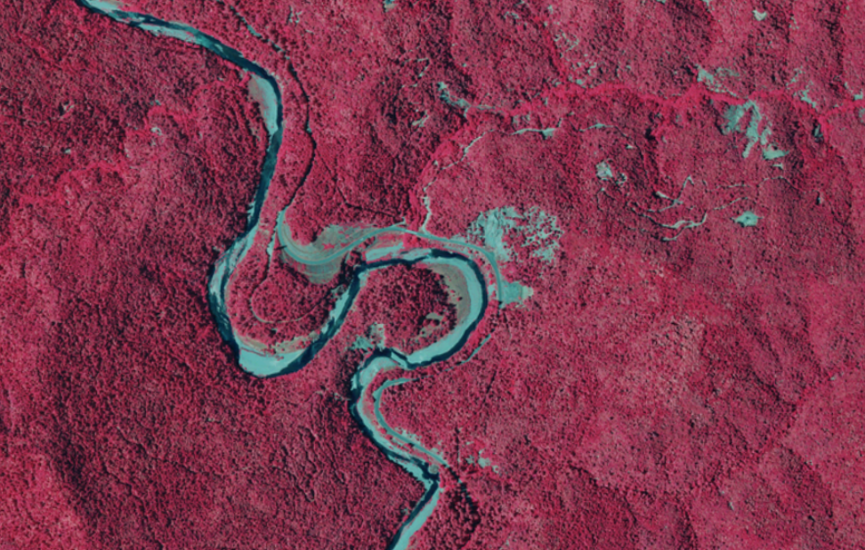
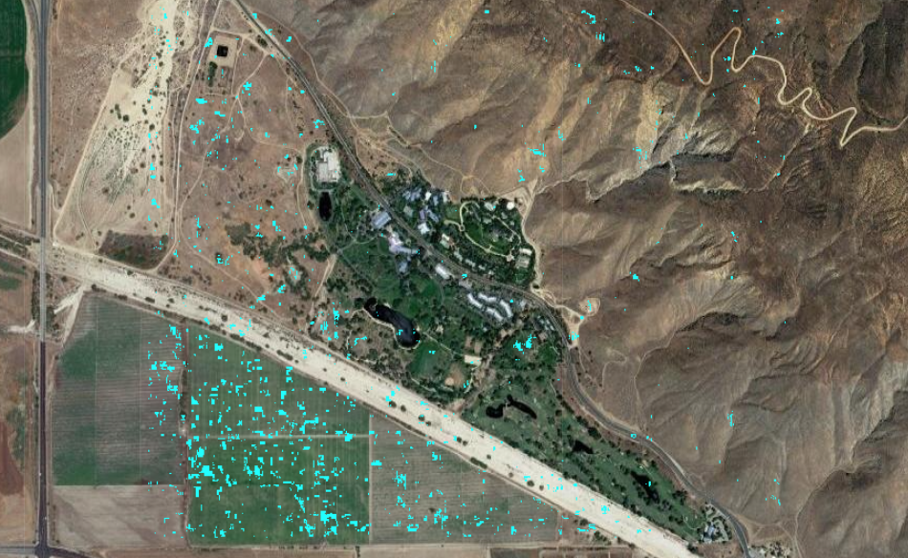
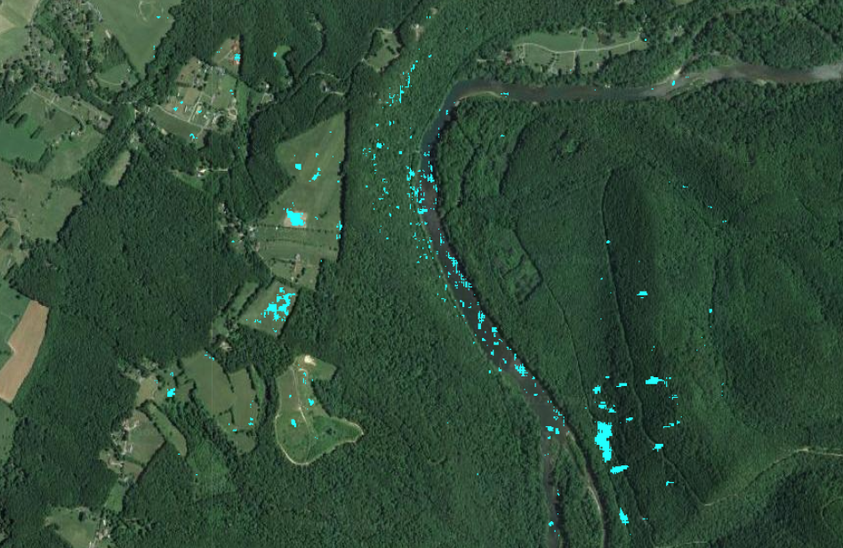
Results: “Fails”

Slide 6
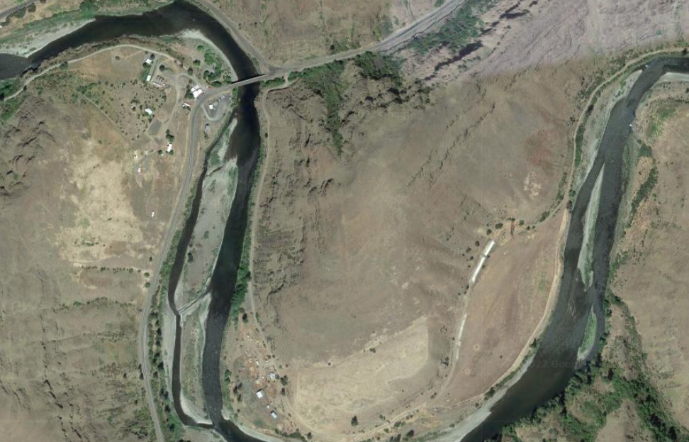
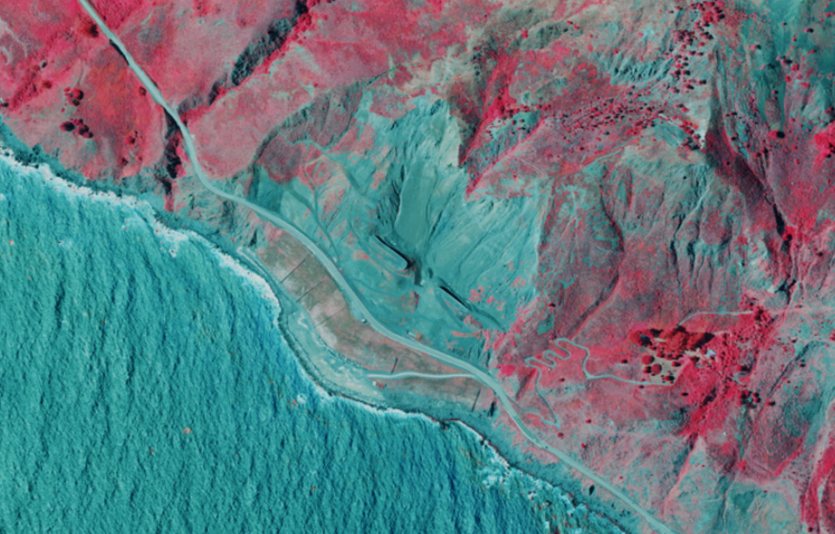
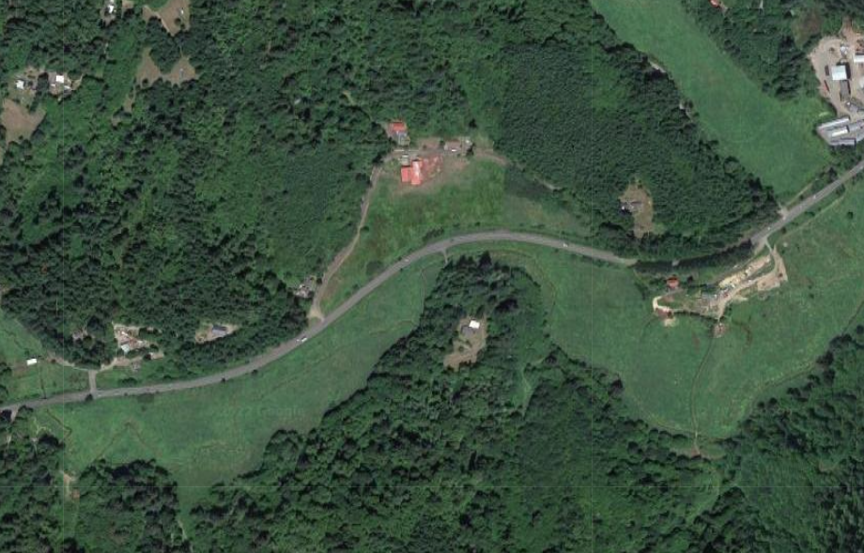
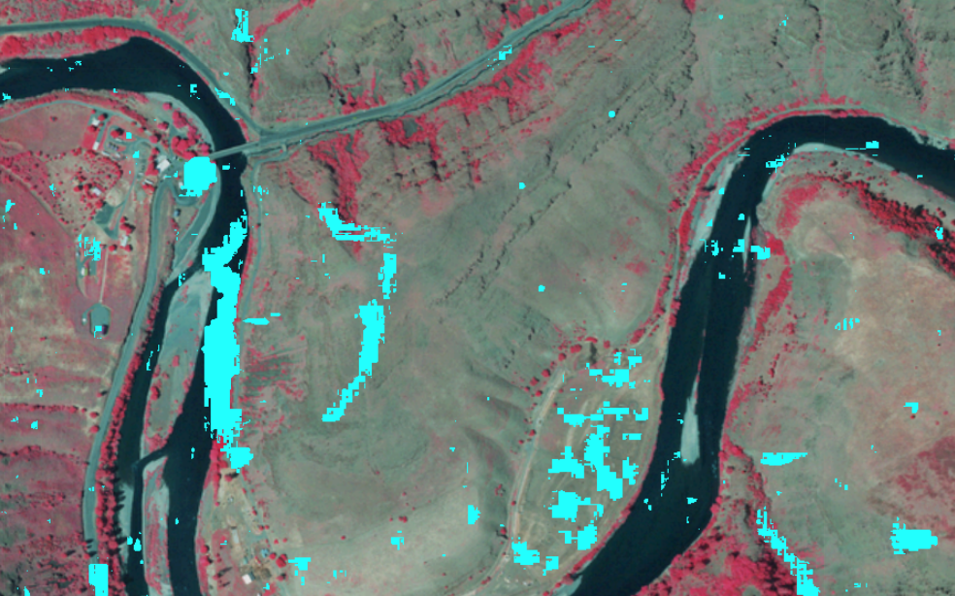
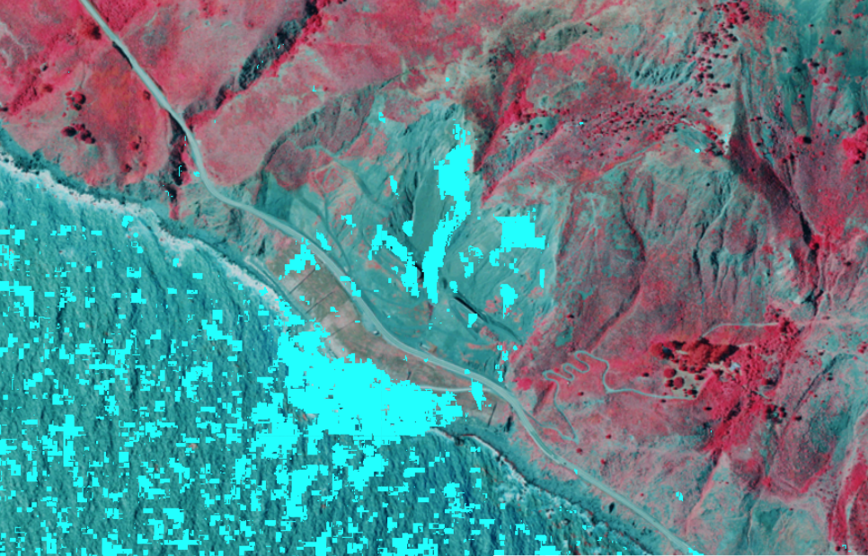
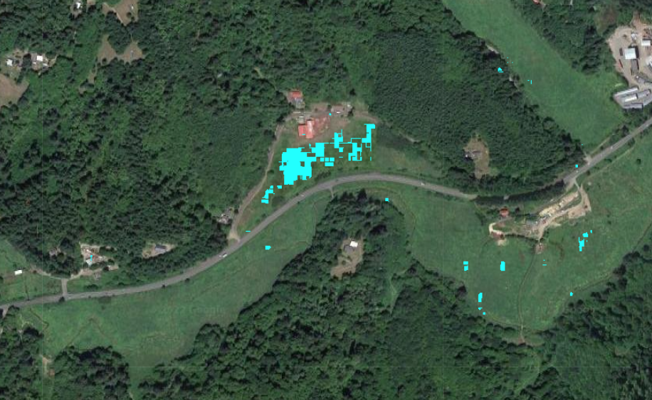
Results: “Successes”

Slide 7
Conclusions

